Slide 1
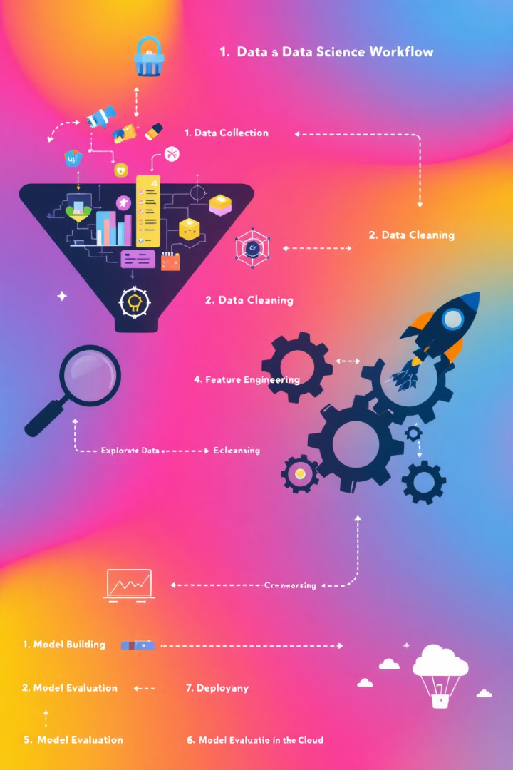

Project Overview
1
Assess Data
Examine dataset characteristics and distributions.
2
Pre-process Data
Prepare data for analysis by standardizing and removing irrelevant features.
3
Choose Model
Select the optimal clustering model and number of clusters.
4
Analyze Results
Name clusters, plot results, and form growth strategies.

Slide 2
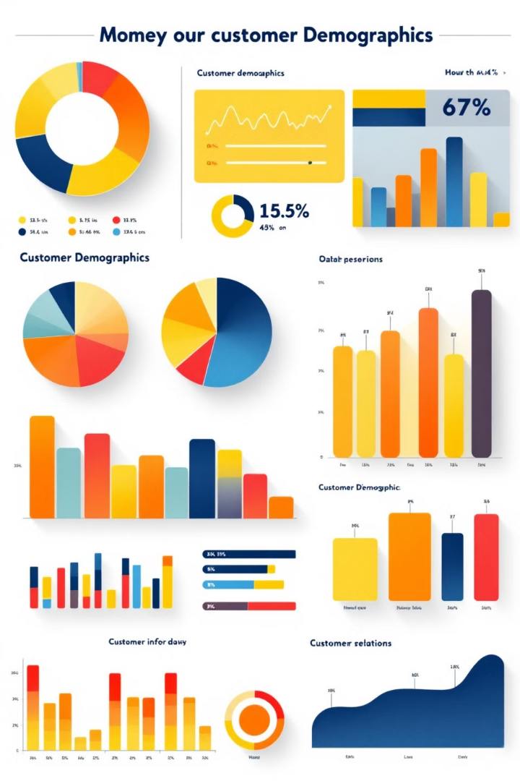
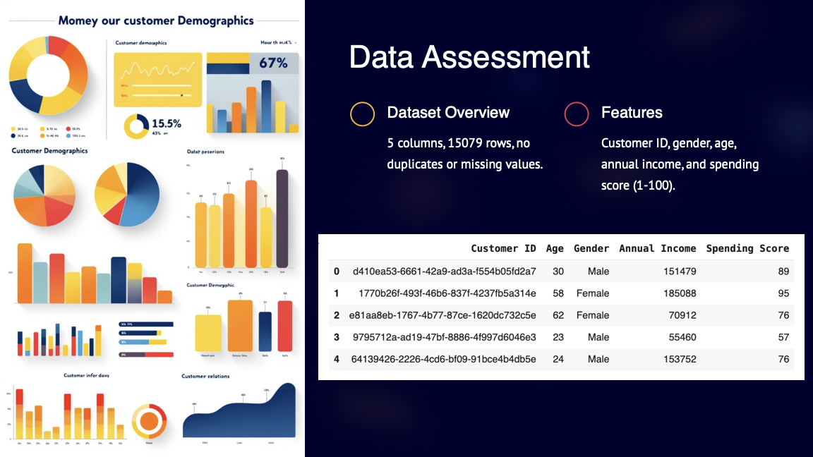
Data Assessment
Dataset Overview
Features
5 columns, 200 rows, no duplicates or missing values.
Customer ID, gender, age, annual income, and spending score (1-100).
Distributions
Age and income slightly right-skewed. Spending score nearly normal.

Slide 3
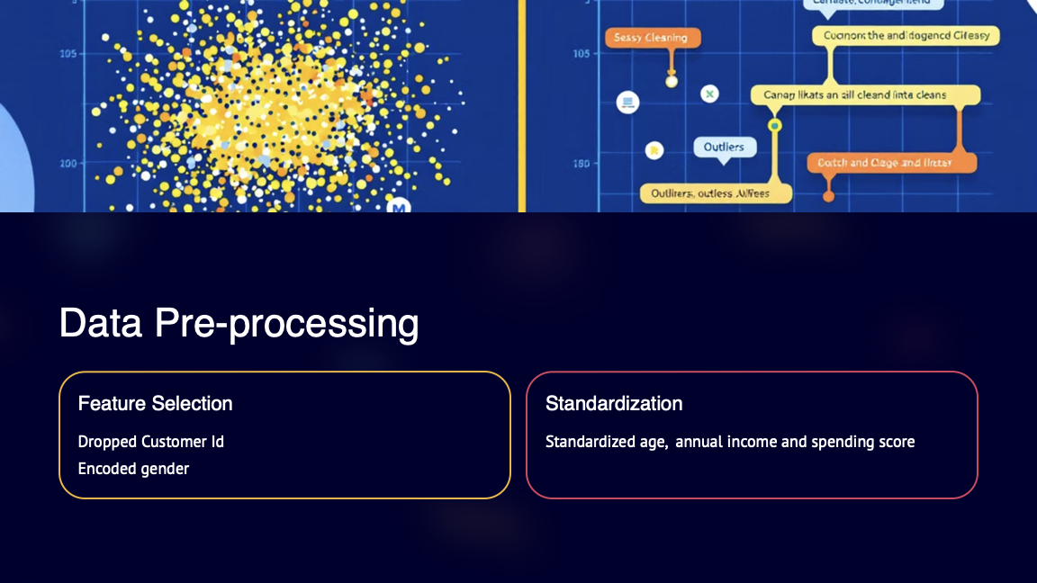
Correlation Analysis
Correlation Heatmap
Implications
No strong correlations between most features. Age and spending score show weak negative correlation (-0.33).
Weak correlations suggest each feature provides unique information for clustering.

Slide 4
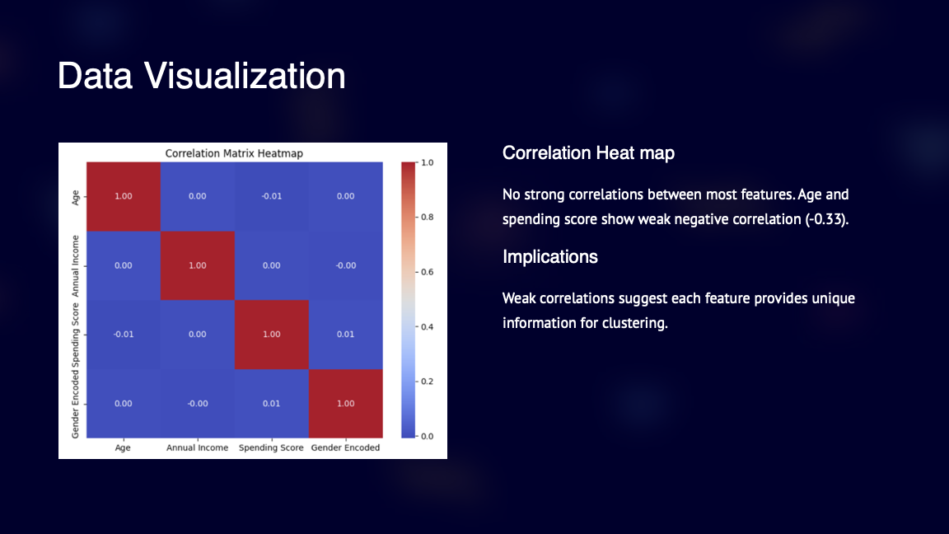
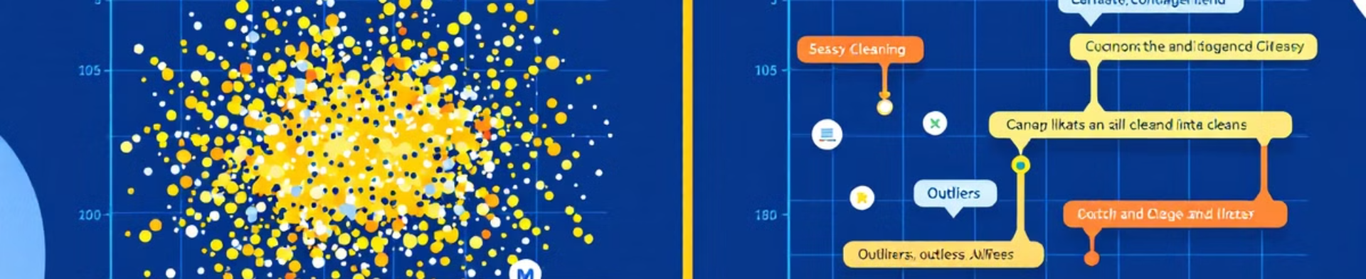
Data Pre-processing
Feature Selection
Standardization
Dropped gender feature as K-means only accepts continuous variables.
Standardized remaining features to ensure similar scale for clustering.

Slide 5
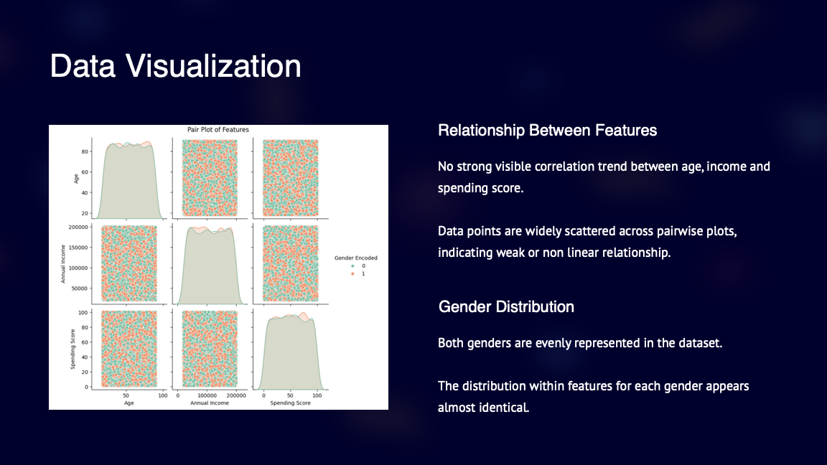
Data Pre-processing
Feature Selection
Standardization
Dropped gender feature as K-means only accepts continuous variables.
Standardized remaining features to ensure similar scale for clustering.

Slide 6
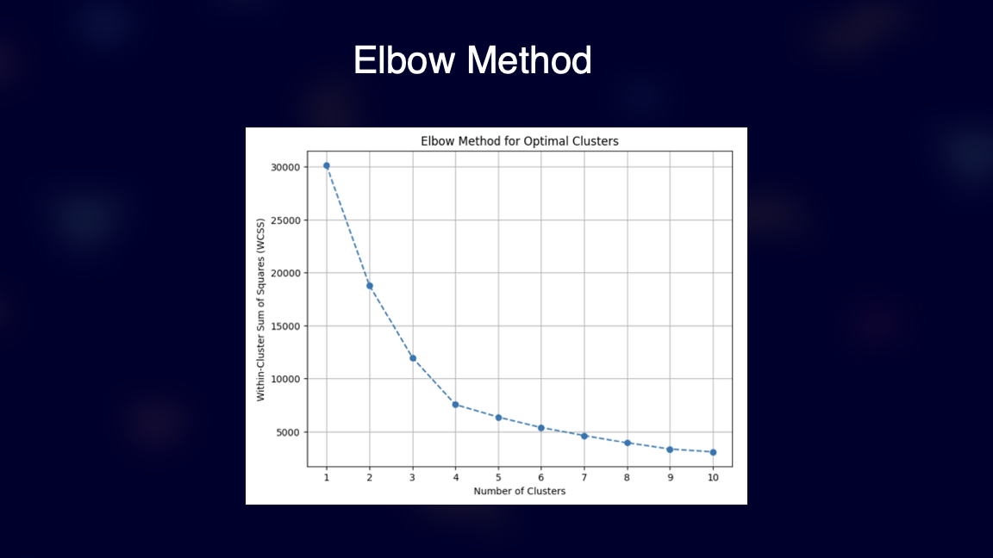
Data Pre-processing
Feature Selection
Standardization
Dropped gender feature as K-means only accepts continuous variables.
Standardized remaining features to ensure similar scale for clustering.

Slide 7
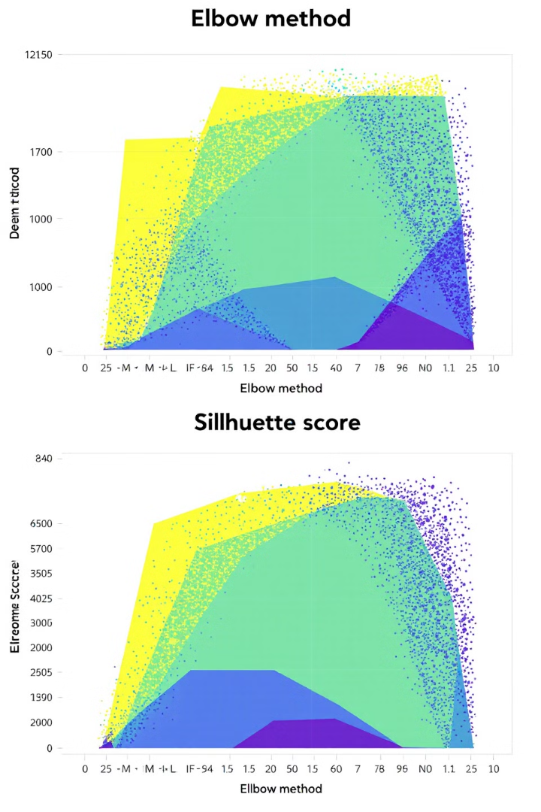
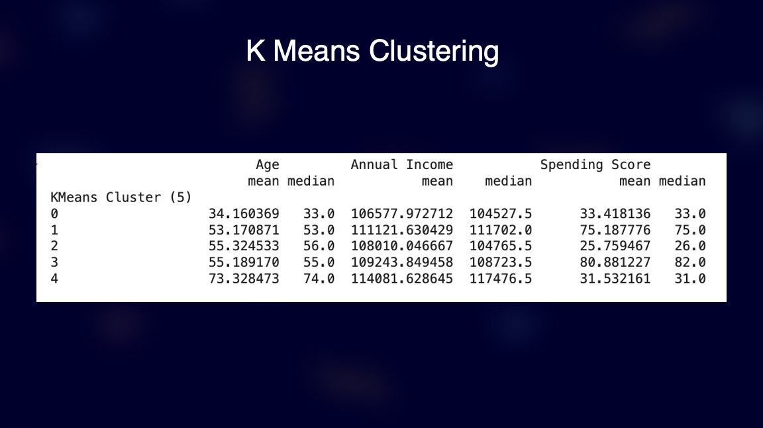
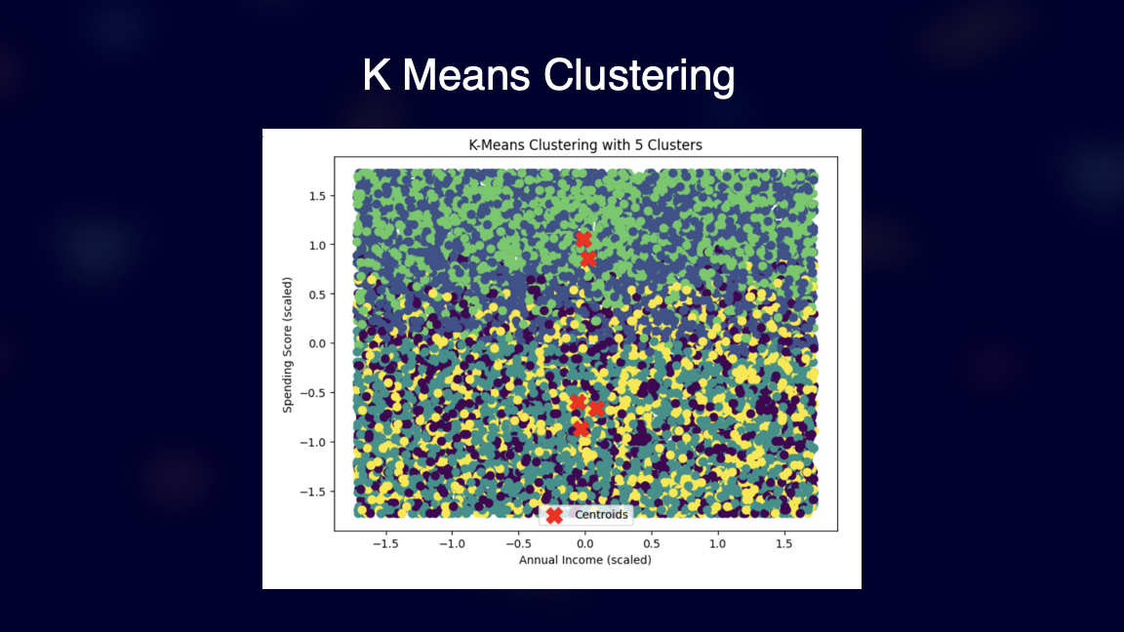

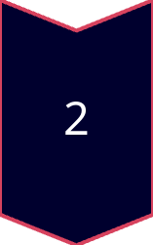
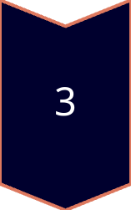
Choosing the Right Model
Elbow Method
Plotted number of clusters vs. sum of square distances.
Silhouette Score
Compared K-means, hierarchical clustering, and GMMs performance.
Final Choice
Selected K-means with k=6 based on highest silhouette score.

Slide 8
Choosing the Right Model
Elbow Method
Plotted number of clusters vs. sum of square distances.
Silhouette Score
Compared K-means, hierarchical clustering, and GMMs performance.
Final Choice
Selected K-means with k=6 based on highest silhouette score.

Slide 9
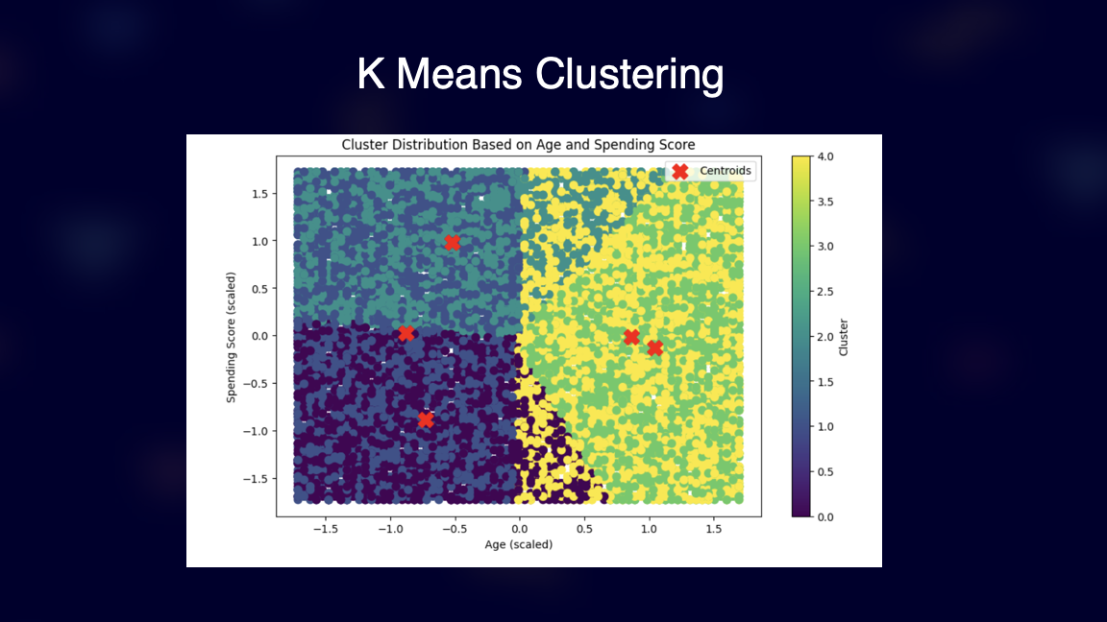
Choosing the Right Model
Elbow Method
Plotted number of clusters vs. sum of square distances.
Silhouette Score
Compared K-means, hierarchical clustering, and GMMs performance.
Final Choice
Selected K-means with k=6 based on highest silhouette score.

Slide 10
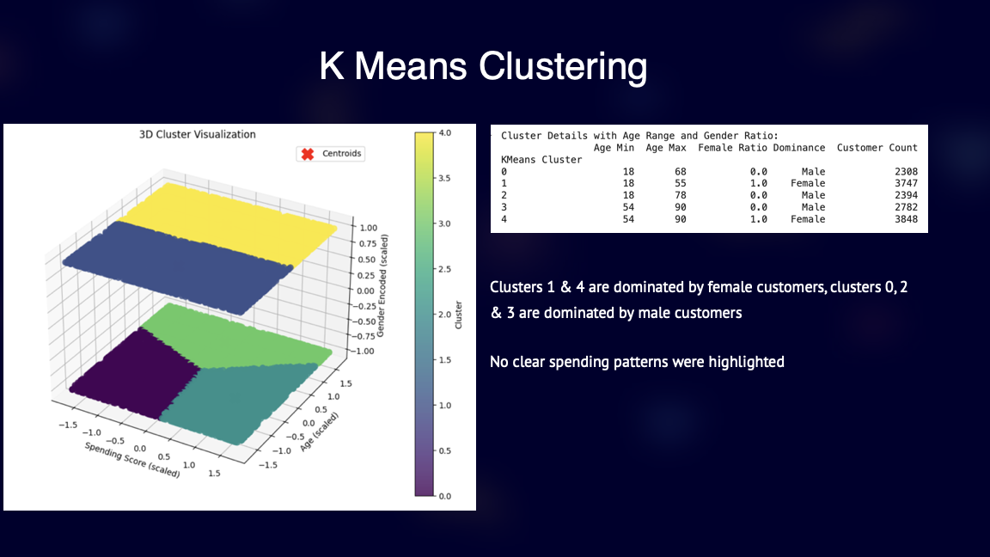
Choosing the Right Model
Elbow Method
Plotted number of clusters vs. sum of square distances.
Silhouette Score
Compared K-means, hierarchical clustering, and GMMs performance.
Final Choice
Selected K-means with k=6 based on highest silhouette score.

Slide 11
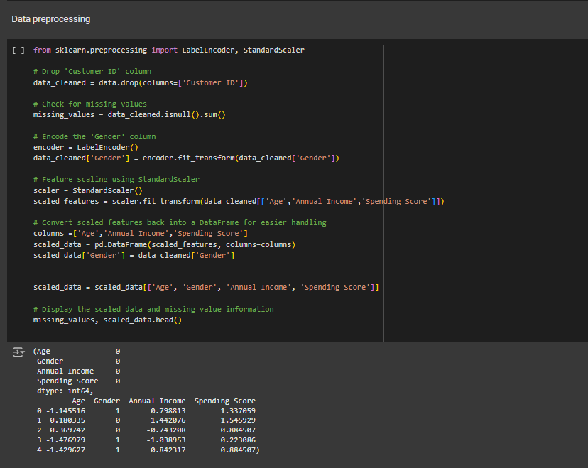

Slide 12
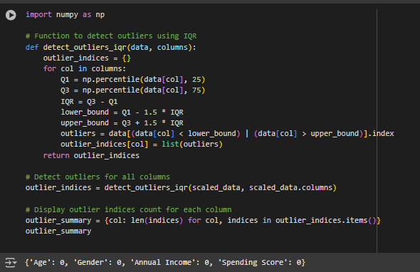
Outlier Detection

Slide 13
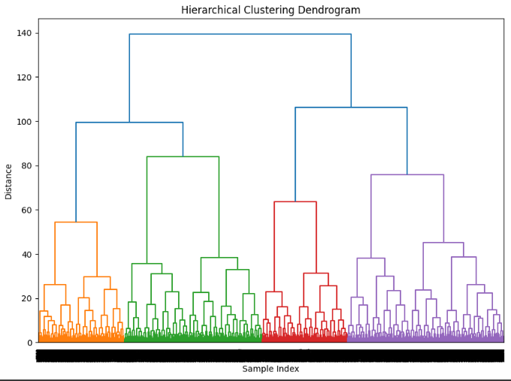
Dendrogram

Slide 14
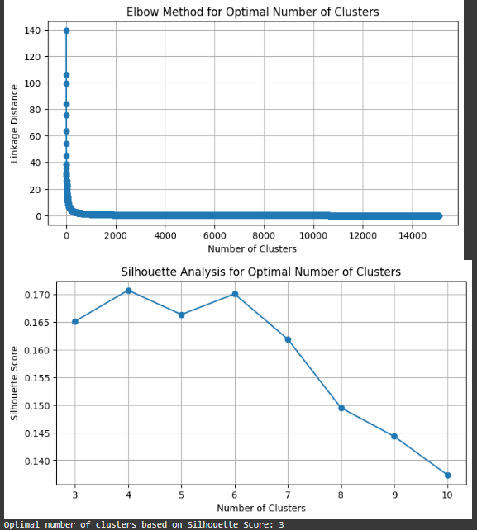
Elbow method and silhouette

Slide 15
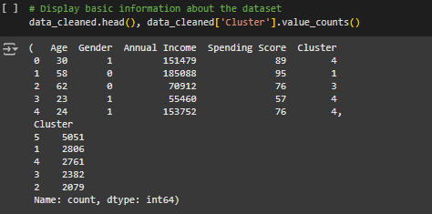
asdasd

Slide 16
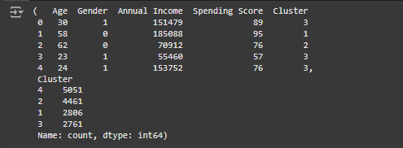
Cluster Count

Slide 17
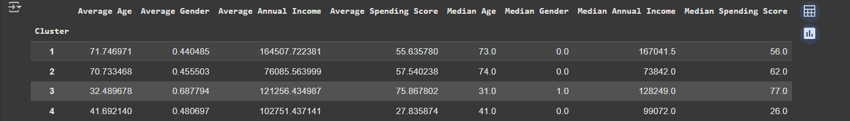
Average and Median values

Slide 18
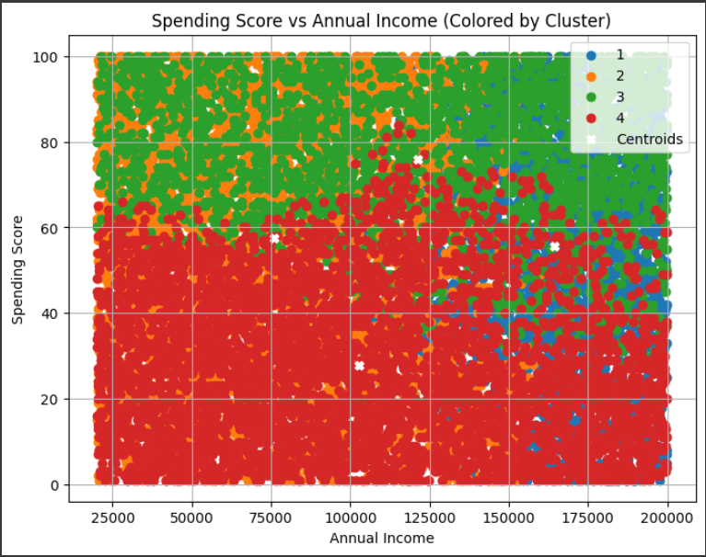

Slide 19
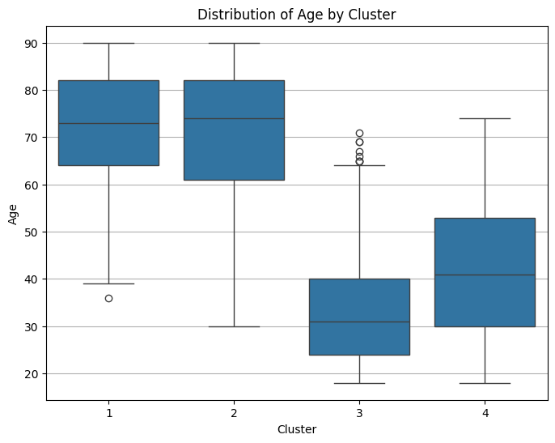

Slide 20
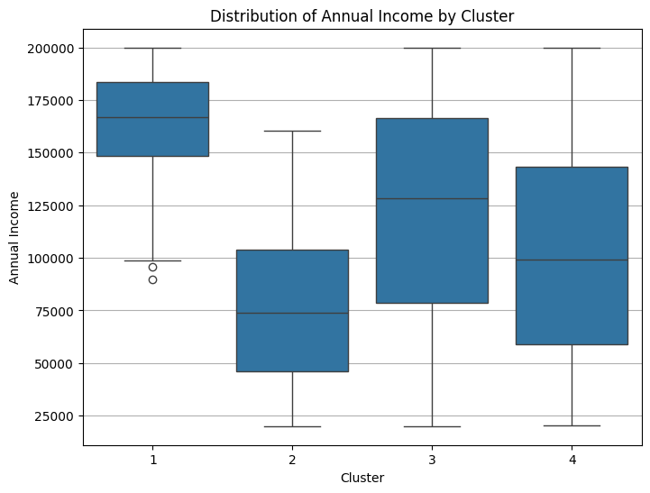

Slide 21
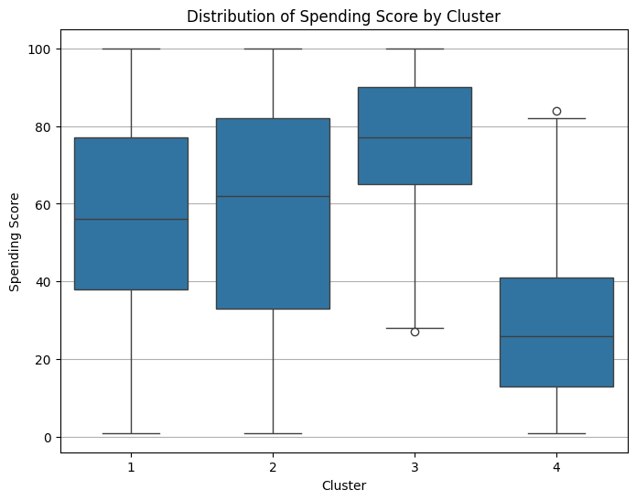

Slide 22
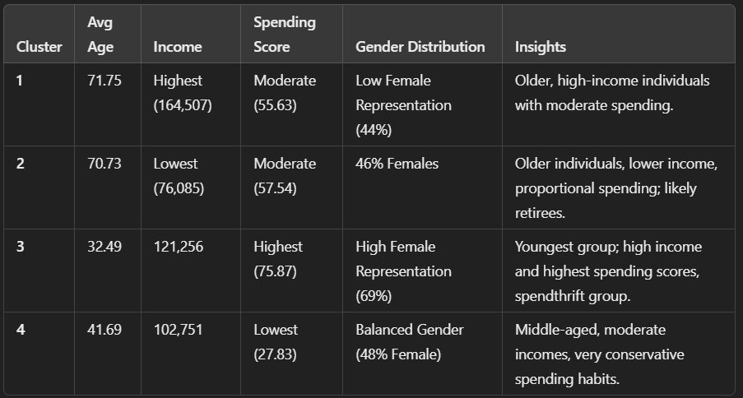

Slide 23
Marketing Strategies
1
Cluster 1: Older, High-Income Individuals
2
2. Cluster 2: Older, Low-Income Individuals
Focus on luxury & premium products (e.g., travel, investments).
Promote health & wellness services.
Use email campaigns and print media (Forbes, AARP).
Emphasize value-based offers (discounts, senior-friendly pricing).
Introduce subscription models for essentials.
Use local media, radio, and community partnerships.
3
Cluster 3: Young, High-Spending Individuals
4
Cluster 4: Middle-Aged, Conservative Spenders
Focus on experiential marketing (travel, events).
Run digital-first campaigns (Instagram, TikTok, influencers).
Implement loyalty & rewards programs.
Highlight practical value and long-term benefits.
Offer bundled deals for families.
Use content marketing (blogs, YouTube demos).

Slide 24
GMM
The Gaussian Mixture Model (GMM) is a clustering algorithm based on probability.
GMM is a type of unsupervised machine learning algorithm that can be used to cluster data.
GMM assumes that your data is generated from a mix of several Gaussian distributions (like bell-shaped curves).
Each cluster is represented by a Gaussian (bell curve), which has its own mean (center) and variance (spread).
GMM handles overlapping clusters better, as it can model the distributions of points more accurately.
Unlike KMeans, which strictly assigns a point to one cluster, GMM gives probabilities.
Notes:
Unlike traditional clustering algorithms like K-means, which assign each data point to a single cluster, GMM allows for soft clustering, meaning that each data point can belong to multiple clusters with different probabilities.
Imagine you have a bag of marbles of different colors. K-means would try to sort the marbles into different piles based on their color, with each marble belonging to only one pile. GMM, on the other hand, would consider the possibility that a marble could be a mix of different colors, and would assign probabilities to each color for each marble.
GMM works by assuming that the data is generated from a mixture of Gaussian distributions. Each Gaussian distribution represents a cluster, and the parameters of the distribution (mean and variance) determine the shape and location of the cluster. GMM then tries to find the best set of Gaussian distributions that can explain the data.
One of the key advantages of GMM is its ability to handle overlapping clusters. In many real-world datasets, clusters may overlap, making it difficult for traditional clustering algorithms to accurately identify the underlying structure. GMM can handle this by assigning probabilities to each cluster for each data point, effectively allowing for partial membership in multiple clusters.
GMM uses the EM algorithm to iteratively:
Estimate the probability that a point belongs to a specific cluster (Expectation step).
Adjust the Gaussian distributions to better fit the data (Maximization step).

Slide 25

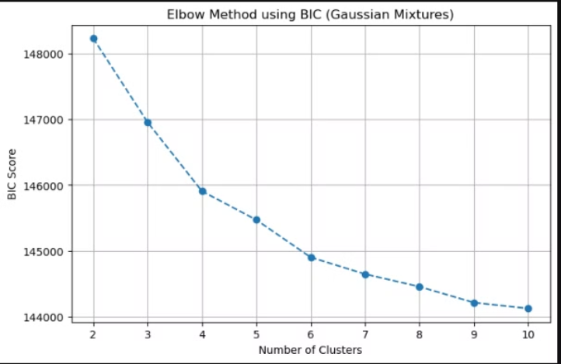
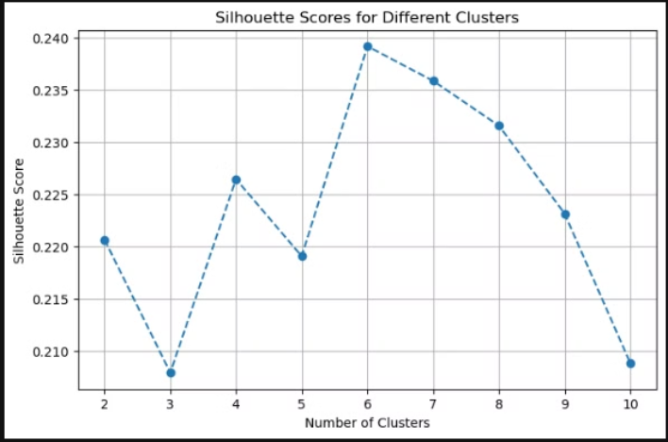
Elbow Method
Silhouette Score
The BIC score is plotted against the number of clusters.
The silhouette score measures how well-separated and cohesive the clusters are.
The "elbow method" suggests looking for a point where increasing the number of clusters doesn't improve the BIC score (or reduce it substantially). If there's a "bend" or "elbow" in the curve, that might suggest a good number of clusters.
It ranges from -1 to 1, where a higher value means clusters are better defined (data points are closer to their own cluster than to others).
By looking at the silhouette score for each k, you can see which cluster number gives a clearer separation.
Silhouette Score: Tells you how well the clusters are actually formed in terms of separation and cohesion.
Elbow Method (BIC): Helps you see how well the model fits the data and when adding more clusters stops giving big improvements. It considers model complexity.
Notes:
In this context, a lower BIC score is generally better. If the decrease in BIC slows down after a certain k, that might be your "elbow."
Bayesian Information Criterion.
AIC (Akaike Information Criterion): Aims to find a model that best approximates the true distribution of data by balancing model fit and complexity, with a focus on minimizing information loss.
BIC (Bayesian Information Criterion): Has a similar goal but is derived from a Bayesian perspective, aiming to identify the model with the highest posterior probability given the data.
Silhouette Score: Tells you how well the clusters are actually formed in terms of separation and cohesion.
After checking both the BIC (for the elbow method) and the silhouette scores, you pick the number of clusters that balances both criteria.
In the code, it prints the best cluster count based on the highest silhouette score.
Elbow Method (BIC): Helps you see how well the model fits the data and when adding more clusters stops giving big improvements. It considers model complexity.
Silhouette Score: Tells you how well the clusters are actually formed in terms of separation and cohesion.

Slide 26
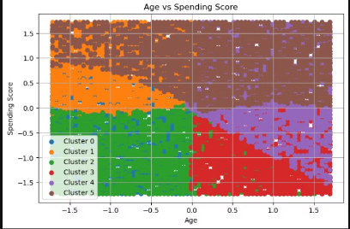
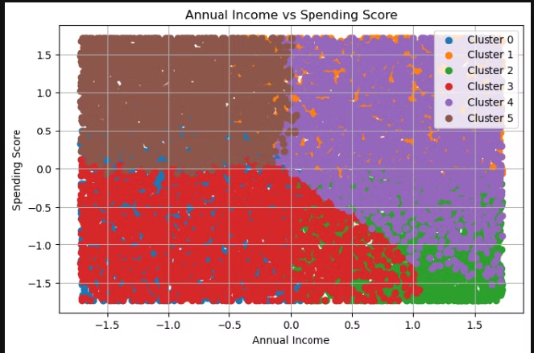
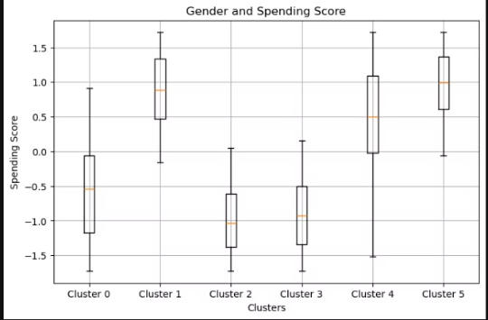
Picture a big grid where each dot represents a customer. The position left-to-right is their age (younger on the left, older on the right) and up-and-down is how much they spend. The colors represent different clusters. If you see that one color dominates a certain area, it means that cluster is made up of customers with those particular age and spending patterns.
Here horizontal line shows how much money the customers make each year, and the vertical line still shows spending habits. Different colored dots form different “clouds” of points, showing that certain clusters represent people with certain income and spending combinations.
These are like a summary of how the spending score varies in each cluster. Each cluster has a box that shows where most people’s spending scores sit. By summarizing the range and median spending scores for each cluster, the box plot clearly shows which clusters are the highest or lowest spenders overall, making it easy to see which groups stand out as particularly spending-heavy or spending-light.
Notes:
How I Used GMM for Mall Customer Segmentation
In the above dataset:
I used Age, Annual Income, and Spending Score as input features.
Segment Customers Based on Key Features:
Age: Younger vs. older customers.
Income: Low, middle, and high-income groups.
Spending Score: How actively a customer spends in the mall.
Customers often exhibit diverse spending behaviors based on their age, income, or other hidden patterns.
GMM helps find these hidden relationships by assuming the data comes from a mixture of Gaussian distributions (e.g., different groups of spenders).
Steps:
Standardized the data (scaled all values to have equal importance).
Applied GMM to find 6 clusters by estimating Gaussian distributions for each cluster.
The model assigned probabilities to each customer, helping to group them into segments based on behavior for targeted marketing, personalized promotions, and improving customer satisfaction.
Data Aggregation:
A box plot summarizes the distribution of spending scores within each cluster.
It shows key metrics like:
Median (central tendency of spending score).
Interquartile Range (IQR) (spread of scores between Q1 and Q3).
Outliers (extremely high or low spending scores).
This is ideal when comparing groups (clusters) to identify general trends across genders.
2. Scatter Plot Limitation for Categorical Variables:
The Gender column is categorical (Male/Female), not continuous.
Scatter plots work best when both axes are numeric. For categorical data like Gender, the X-axis would appear repetitive (e.g., points "Male" and "Female" scattered horizontally).
A scatter plot might become noisy and harder to interpret when there are many points for each gender.
3. Box Plot Simplicity:
In a box plot, you can quickly spot:
Whether males or females in specific clusters have higher spending scores.
The variability (spread) in spending scores within each cluster.
Comparisons between clusters at a glance.
This makes box plots cleaner and more informative for summarizing gender-based spending trends.
When to Use Scatter Plot?
If we were analyzing Age vs Spending Score or Income vs Spending Score, where both variables are numeric, a scatter plot would be more suitable.
In those cases, scatter plots help identify relationships and patterns between variables.

Slide 27
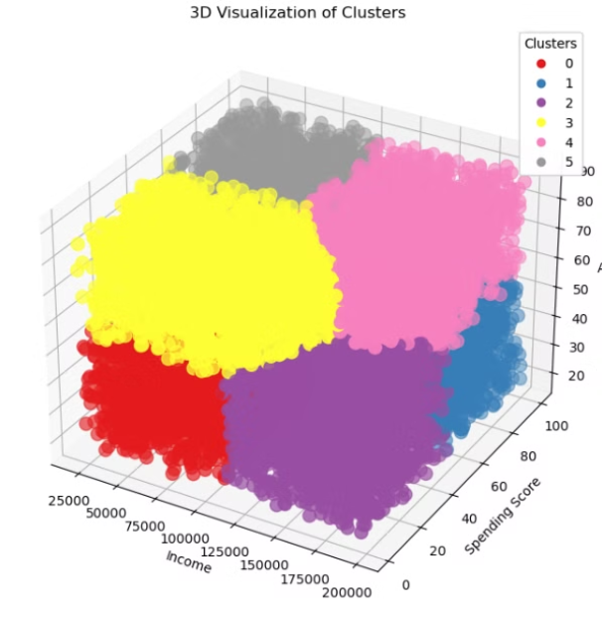
This 3D plot shows all customers placed according to their Income (x-axis), Spending Score (y-axis), and Age (z-axis). Each point represents one customer, and the color of the point indicates which cluster they belong to. Since each cluster forms a distinct “cloud” of points in 3D space, it’s easier to see how the clustering algorithm (Gaussian Mixture Model, in this case) has grouped similar customers together. Essentially, customers in the same colored cloud share similar ranges of income, spending behavior, and age, while customers in different colored clouds are more distinct.
Notes:
GMM helps identify customer segments based on their behavior:
High spenders vs. low spenders
Young shoppers vs. older shoppers
Middle-income vs. high-income groups

Slide 28
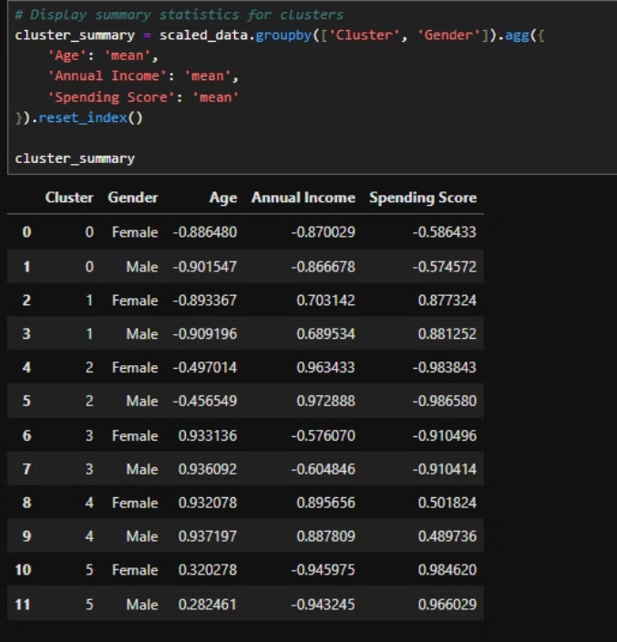
There are at least 6 clusters (Cluster 0 to Cluster 5), each grouping individuals with similar spending patterns, age, and income.
Gender Distribution: Each cluster has both Male and Female members, but further analysis or visualization can show which gender dominates each cluster. Age and Income:
For example: Row 0: Cluster 0 has a Female with below-average Age, Annual Income, and Spending Score.
Row 5: Cluster 2 has a Male with below-average Annual Income and Spending Score. Spending Behavior:
Positive Spending Score values (e.g., Clusters 3 and 4) indicate individuals who spend more than the average. Negative Spending Score values (e.g., Clusters 0, 1, and 2) represent more conservative spenders.
Notes:
This table displays clustered data resulting from Gaussian Mixture Model (GMM) clustering.
Cluster: The cluster number assigned to each data point. It indicates which group the record belongs to after clustering.
Gender: 'Male' or 'Female' indicates the gender of the individual in that row.
Age: The standardized (scaled) value of the Age variable. Negative or positive values represent deviations from the mean, as the data was scaled using StandardScaler.
Annual Income: The standardized value of Annual Income. Similar to "Age," it shows how each individual deviates from the average annual income.
Spending Score: The standardized Spending Score. Higher positive or lower negative values indicate how actively someone spends relative to the group mean.

Slide 29
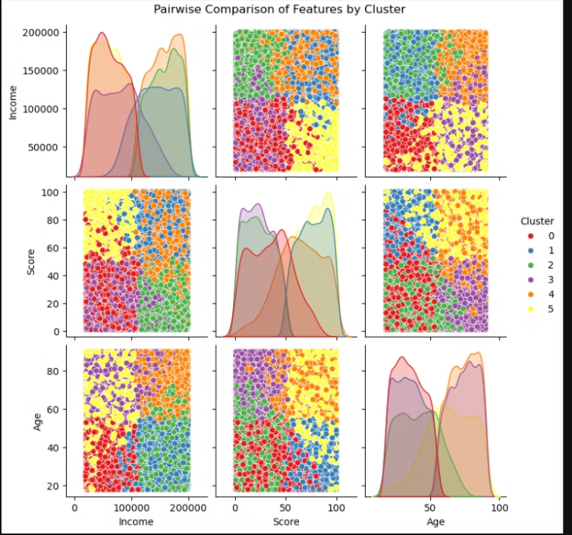
Diagonals (Density Plots): The diagonal plots show how each cluster's data is distributed for a single feature (like Income, Score, or Age). Each colored curve represents a cluster, so if a cluster’s curve is shifted toward higher values, that cluster tends to have higher values for that feature.
Off-Diagonal (Scatter Plots): The off-diagonal scatter plots compare two features at once. Each dot is a customer, colored by their cluster. If you see distinct “clouds” of the same color, it means those clusters are well-separated and the algorithm effectively grouped similar customers together.
Notes:
This figure is a "pairwise comparison" or "pairplot" of the three main features: Income, Score, and Age. Essentially, it’s showing every combination of these features two at a time, along with their individual distributions. The dataset has been clustered using a Gaussian Mixture Model (GMM) into 6 clusters, and each data point is colored by the cluster it belongs to.
Key Observations:
Income vs Spending Score:
Clusters are clearly separated here:
Red and Purple clusters (low income and low spenders): These customers are conservative spenders.
Yellow and Orange clusters (high spending scores, mid to high income): Likely impulsive or luxury buyers.
Green (moderate spenders, high income): Balanced spending behavior.
Age vs Spending Score:
Younger customers (left side) are spread across clusters with high and low spending scores.
For example:
Yellow Red Cluster (low spCluster (high spenders, younger age group).
enders, younger age group).
Older customers (right side) lean toward lower spending scores, visible in the clusters.
Income vs Age:
Clusters split income into ranges:
Low-income customers appear at all age levels.
High-income customers tend to be older or mid-aged (visible in Green and Orange Clusters).

Slide 30
Cluster Analysis Insights and Targeted Marketing Plans
Cluster Distribution for Each Gender Observation: The clusters contain varying proportions of males and females. This helps in understanding whether specific spending patterns are gender-dominant, enabling targeted strategies.
Business Insights from Clusters:
Age vs. Spending: Younger customers (20–35) often appear in higher-spending clusters, suggesting that lifestyle or tech-oriented promotions may resonate strongly with them.
Income Variation: Higher-income groups show diverse spending behaviors. Some need premium products or loyalty incentives to increase their engagement, while others spend freely.
Gender Influence: Clusters blend genders, but certain groups lean toward one gender. For instance, female-dominated high-spending clusters might respond well to fashion and lifestyle offers, while male-leaning moderate-spending clusters could appreciate electronics or automotive deals.
High-Spending Clusters: Focus on clusters with elevated spending scores. Introduce premium products, exclusive events, and personalized services to maximize revenue and brand loyalty within these segments.
Low-Spending Clusters: Employ budget-friendly options, promotions, and discounts to encourage higher engagement. Over time, these customers can be guided toward more profitable behaviors.
Targeted Campaigns: Use demographic insights—age, income, and gender—to deliver highly tailored marketing strategies, ensuring better satisfaction and long-term loyalty.
Notes:
Business Insights from GMM for Mall Management:
Using the clusters created by GMM, we can extract actionable insights:
Targeted Marketing Campaigns:
Identify high-spending customers (e.g., Cluster A) and offer them loyalty programs or premium product discounts.
For low-spending groups (e.g., Cluster B), provide special offers to encourage more visits.
Customized Product Placement:
Young customers with high spending scores might prefer tech gadgets or fashion items.
Middle-income customers may seek value-for-money deals.
Improved Resource Allocation:
Mall managers can prioritize marketing budgets toward clusters with the highest spending potential.
Understand foot traffic better to optimize store placements.
GMM for Future Predictions:
Customer Behavior Prediction:
Use historical data to predict future cluster memberships.
Example: Predict if a low spender might become a high spender based on spending trends.
Personalized Marketing:
Combine GMM clustering with customer purchase history to design personalized offers for each segment.
New Customer Segmentation:
When new customers enter the mall, GMM can assign them to appropriate clusters based on their features (e.g., age, income).
Trend Analysis:
Track how clusters evolve over time (e.g., growth in high-spender clusters), helping businesses adjust their strategies dynamically.

Slide 31
Conclusion and Next Steps
Implement Strategies
Monitor Performance
Refine Approach

